Slide 1
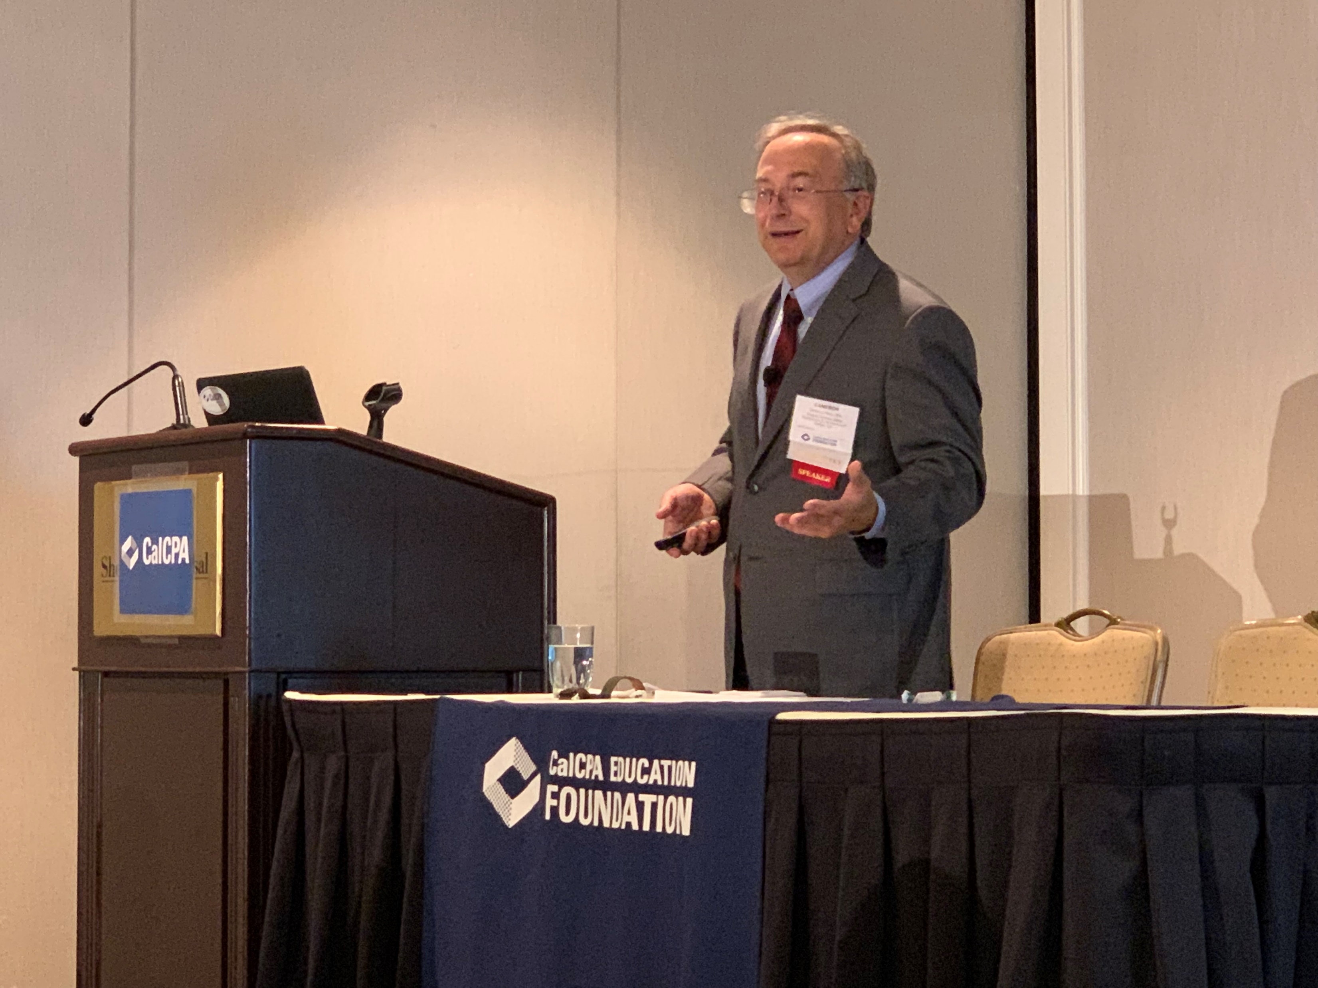
Proposition 19: What hath we wrought?
Cameron L Hess, Esq., CPA
Wagner Kirkman Blaine Klomparens & Youmans LLP
chess@wkblaw.com
(916) 920-5286

Slide 2
Overview of Proposition 19
This program is for educational use. It does not cover all provisions of Proposition 19 or current law. This program assumes some understanding of Proposition 13 basics.
Slides are Color Coded:
Yellow Caption – Current Law - Before Proposition 19 Effective
Green Caption – Proposition 19
Charts – Compare Old Law and New Law
Blue Caption – Planning–Before/After Proposition 19 Effective

Slide 3
Overview of Proposition 19
New Provisions:
Approved November 3, 2020
Makes Changes to Proposition 13 (Amends Ca Constitution)
Expands some exemptions; mostly limits others.
Does not eliminate Prop 13 “basics” (Prop 15 failed)
Effective Date for Changes:
Base-Year Value – Transfers – 4/1/21 and Later
Parent-Child or Grand-Parent-Child –2/16/21 and Later

Slide 4
Prop 60/90 (1986/1988) – Ending 3/31/21
Expiring Provision:
Transfers of Base-Year Value for “Seniors” (One-Time)
Current (Pre-Prop 19): aka “Downsizing for Seniors”
One-time transfer base-year value to new home if 55-years or older
Required: Principal Residence + Eligible for HO or Disabled Exemption
New Home: Located same county or a Prop 90 Reciprocal County*
New Home: (i) Already own or (ii) acquired/built within 2-year.
Effect: Transfers same base-year value from old to new home.
*Reciprocity: Only 10 of 58 Counties. ☹

Slide 5
Prop 60/90 (1986) – Ending 3/31/21
Expiring Provision:
Claim: Within 3-Years of Acquiring New Home
Old Home’s FMV: ANY AMOUNT
New Home’s FMV: (Pass/Fail Test):
If already own: FMV of New Home: = or < FMV Old Home
If purchase/build later: 105% - 1st Year; 110% - 2nd Year
Special considerations
Lots of situations, like a pending marriage
Prop 110: also allowed for Severely/Permanently Disabled (one-time)
All ends 3/31/21 (can not use Prop 60/90 on later replacement.)

Slide 6
Prop 19– Senior Base-Year Transfers-4/1/21+
New Provisions:
Claim: (3-years? Of) Acquiring New Home
Transfer base-year value to new home if 55-years or older
Old Home FMV: Any amount (no change)
NEW: May claim 3 Times (4th home) – unclear – old transfers too?
NEW: New Home FMV ($0/Partial Exemption):
If New Home =/< FMV Old Home: Base-Year Value Carries (no change)
If > FMV Old Home: Partial reassessment – increased FMV reassessed
NEW: Intercounty Transfers Allowed – Anywhere (58 Counties!)
Effective 4/1/2021 - Unclear: old home pre 4/1, new home 4/1+

Slide 7
Prop 19– Seniors Base-Year Transfers-4/1/21+
New Provisions:
Claim: (3-years? Of) Acquiring New Home
Severely/permanently disabled
New law is same as seniors: Right to transfer base-year 3 times.
Expect BOE to set up database to track for all counties.
Six Transfers Allowed? – 3 for disability & 3 for over 55? – Maybe.
As a Constitutional Amendment – no statue/forms yet:
California legislation (R&T Code) will be forthcoming later
BOE will issue forms for counties use later

Slide 8
BASE YEAR VALUE TRANSFER – PERSONS AT LEAST AGE 55/DISABLED
 | Current Law | Proposition 19
Type of Property | Principal residence | Principal residence
Timing | Purchase or newly construct residence within 2 years of sale | Purchase or newly construct residence within 2 years of sale
Location of Replacement Home | Same county County with intercounty ordinance (10 counties) | Anywhere in California
Value Limit | Equal or lesser value 100% if replacement purchased/new construction prior to sale 105% if replacement purchased/new construction in first year after sale 110% if replacement purchased/new construction in second year after sale | Any value Amount above 100% is added to transferred value
How many transfers? | One time Exception: After using once for age, second time for subsequent disability | Three times
Implementing Statute | Revenue & Taxation Code section 69.5 (implements Propositions 60/90/110) | To be determined
Important Dates | Through March 31, 2021 | Effective April 1, 2021
CHART #1

Slide 9
Props 3 &10- [Calamity – Ending 3/31/21]
Base-Year Value Carry-over For
Eminent Domain/Inverse Condemnation – NO CHANGE. ☺
Substantial Destruction (50% FMV loss) – Current rules end 3/31/21
Any Real Property (home, rental, business) – One Time Right
Replace: 5-Years Substantial Destruction – similar size, use, function.
Claim Exemption “anytime” (timely - first 4-years retroactive)
New Property FMV – Carryover rule (ending 3/21/21)
If FMV New Property < 120% FMV Old Property: Base-year carry-over (100%)
If FMV New Property > 120% higher, reassess only increase > 120%.

Slide 10
Props 3 &10- Calamity – Ending 3/31/21
Eminent Domain/Inverse Condemnation
– may replace in any California county.
Formally Declared Disaster (State)
– replace only in same county or in a reciprocating county.

Slide 11
Prop 19– Limiting Calamity Relief – 4/1/21
New Provisions:
Simple Explanation:
If your business/rental burns down in a disaster area, you may no longer rebuild somewhere else in the county and get property tax relief on the replacement.
If your principal residence burns down in a disaster area, you may buy another for any value. If new house has a higher value, it will be partly reassessed (for FMV increase). You only have 2-years to replace.

Slide 12
Prop 19– Limiting Calamity Relief
New Provisions:
Replace principal residence within 2-years of sale
Gone – All Other Property! – No Base-Year Transfer to New Property
New Limit: Can only transfer to new principal residence
Calamity Definition – same 50% value decline; Some terms slightly different.
Primary Residence + HO Exemption or Disabled Veterans
Replacement: 5-years from calamity 2-years from sale.
Gone: 120% Protection
If New Home > FMV Old Home Calamity – partial reassessment
Inter-county Transfer is okay – Anywhere (58 Counties!)
Effective 4/1/2021 - Unclear: old home pre 4/1, new home 4/1+

Slide 13
Prop 19– Limiting Calamity Relief
No change: Property lost to eminent domain, inverse condemnation.
These are still under the old rules.

Slide 14
BASE YEAR VALUE TRANSFER – INTRACOUNTY DISASTER RELIEF
 | Current Law | Proposition 19
Type of Property | Any type of property | Principal residence
Timing | Purchase or newly construct property within 5 years of disaster | Purchase or newly construct residence within 2 years of sale
Location of Replacement Property | Within same county | Anywhere in California
Value Limit | Any value Amount above 120% is added to transferred value | Any value Amount above 100% is added to transferred value
Type of Disaster | Disaster for which the Governor proclaims a state of emergency | Wildfire, as defined, or natural disaster as declared by the Governor
Implementing Statute | Revenue & Taxation Code section 69 (implements Proposition 50) | To be determined
Important Dates | Through March 31, 2021 | Effective April 1, 2021

Slide 15
BASE YEAR VALUE TRANSFER – INTERCOUNTY DISASTER RELIEF
 | Current Law | Proposition 19
Type of Property | Principal residence | Principal residence
Timing | Purchase or newly construct principal residence within 3 years of disaster | Purchase or newly construct principal residence within 2 years of sale
Location of Replacement Home | County with intercounty ordinance (13 counties) | Anywhere in California
Value Limit | Equal or lesser value 105% if purchased/new construction in first year after disaster 110% if purchased/new construction in second year after disaster 115% if purchased/new construction in third year after disaster | Any value Amount above 100% is added to transferred value
Type of Disaster | Disaster for which the Governor proclaims a state of emergency | Wildfire, as defined, or natural disaster as declared by the Governor
Implementing Statute | Revenue & Taxation Code section 69.3 (implements Proposition 171) | To be determined
Important Dates | Through March 31, 2021 | Effective April 1, 2021

Slide 16
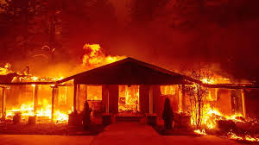
Calamity Change - Why do We Care?
Planning
2017-Year (10,280 Structures)
Sonoma Complex Fire
2018-Year (24,266 Structures)
Camp Fire (Butte County – 18,800 structures)
2019-Year (732 Structures.
Sandalwood Fire (Riverside County)
Saddle Ridge Fire (Los Angeles County)
Kincade Fire (Sonoma County – 174 homes)
2020-year (10,488 Structures)
LNU Lightning Complex Fire (8/17/20 – 10/2/20)
Need to Clarify: Which set of rules apply? [Prediction: Based on replacement (?)]

Slide 17
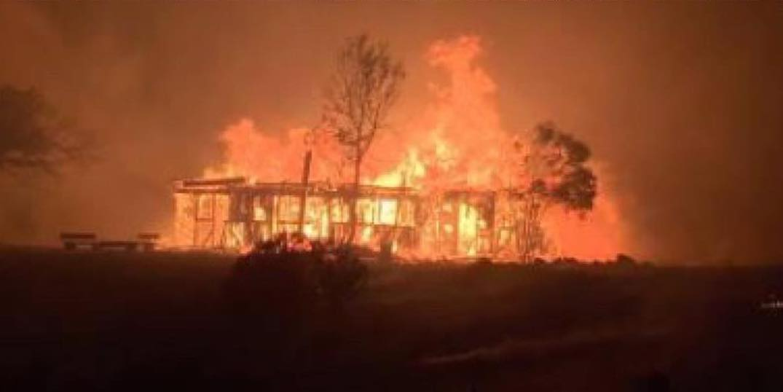
Calamity Change - Planning
Planning
Property Not a Personal Residence
Example: Rental or business property
Section 170, disaster value reduction still permitted (same property)
Section 194.1, deferral of first installment still permitted (same property)
May replace by different property on or before 3/31/2021

Slide 18
Parent-Child Transfer Excl’n (Prop 58)-2/15/21
Expiring Provision:
Transfer Base-Year Value to Children (1986)
Claim later of: i) 3-yrs or 6 mths from supplemental
Any personal residence if qualified for HO exclusion (No limit on #)
Child receiving not required to live there.
Other real property. Limit: $1 million total lifetime (estate) “base-year” transfers. (No portability.) BOE tracks everyone and every transfer.

Slide 19
Parent-Child Transfer Excl’n (Prop 58)-2/15/21
Expiring Provision:
Right to Transfer Base-Year Value to Children
Old Rule
Sale, gift or bequest okay – any transfer
Extended to grandparent-grandchild (Prop 193, 1996)
Preamble: Step-transaction doctrine won’t apply
Lots of planning opportunities – business, rentals.
Ends 2/15/2021.

Slide 20
New Provisions:
Prop 19– Parent-Child Transfer Limited
Parent-Child Exclusion: Claim is limited & 1-Year from Transfer
Principal Residence - Changed
No Change: Principal residence “eligible” for HO or Disabled Veterans Exemption
New: Must “Continue as the family home of the transferee”.
Family Farm – must contain a principal residence.
Partial Reassessment New – avoid only first $1M reassessment
No Reassessment: If FMV is less than “Factored Value + $1 million.
Reassessment. Excess supplemental/escape assessment > $1 million is reassessed.
Example - $200,000 Base-Year Value; $1.5 million FMV.
If qualified, new base-year will be $500K ($200K + $300K ($1.5 - $1.2))

Slide 21
New Provisions:
Prop 19– Parent-Child Transfer Limited
$1 million “exclusion”
Indexed annually beginning 2/1/2023 for CPI for prior calendar year.
Family Farm
Real property under cultivation for pasture or grazing or used to produce an Agricultural Commodity
Allowed same limited protection.
No other business is protected.
Ex: 200 Acre Nut Family Farm, with Shop/Office/Building. $800,000 assessed value ($8,000 Tax). FMV $4 million. At death, will be reassessed to $3 Million ($30,000 Tax) (800K + $4M - $1.8M)

Slide 22
PARENT-CHILD & GRANDPARENT-GRANDCHILD EXCLUSION
 | Current Law | Proposition 19
Principal Residence | Principal residence of transferor No value limit Residence and homesite (excess land may be excluded as "other property") | Principal residence of transferor and transferee Value limit of current taxable value plus $1,000,000 (as annually adjusted) Family homes and farms
Other Real Property | Transferor lifetime limit of $1,000,000 of factored base year value | Eliminates exclusion for other real property other than the principal residence
Grandparent-Grandchild Middle Generation Limit | Parent(s) of grandchild, who qualifies as child(ren) of grandparent, must be deceased on date of transfer | No change: parent(s) of grandchild, who qualifies as child(ren) of grandparent, must be deceased on date of transfer
Filing Period | File claim within 3 years or before transfer to third party | File for homeowners' exemption within 1 year of transfer
Implementing Statute | Revenue & Taxation Code section 63.1 (implements Propositions 58/193) | To be determined
Important Dates | Through February 15, 2021 | Effective February 16, 2021

Slide 23
Planning Strategies
Planning
Transfer Property Under Old Rules Before they Expire
Deed real property for family business (Non-Ag) to children.
ACE hardware, restaurant space, if property tax increase will “kill” business”.
Warning – Must directly own property. If held in corporation/LLC planning won’t work.
Options:
Gift (But No-Step-up)
Sale – Installment Sale of Property to Children
Problem – Cash Flow
Problem – SCIN may result in capital gain in situation where there was no estate tax. (No substitution of taxes.)

Slide 24
Planning Strategies
Planning
Use Parent-Child Transfer Early
Prop 58: $1,000,000 Assessed Value or Principal Residence Exclusion.
Discussed Above
Joint Tenancy? – Harder than you think!
First TIC Transfer (Parent-Child Exclusion Claimed)
Second Joint Tenancy. Rule 462.040(b)
Problem: Co-tenants → Joint Tenants (% Interest Must Remain Same)
Risks: Step-Transaction Doctrine?

Slide 25
Planning Strategies
Planning
LLC Planning – If Used Proportionate Transfer Rule Previously
(Was Cotenant/LP Before and now LLC)
Problem: Change in Control = both anyone > 50% owner or lose > 50% original owners %.
How:
1st Deed: Owners out of LLC Proportionately.
2nd Deed: Owners gift to children,
3rd Deed: Recontribute property back-in. Extend life of partnership.
LLC Planning – If PTR Never Used (Property Purchased)
The “Dell” (Ocean Avenue) Planning. Avoid heir getting 51% ownership.
Fraction out interests so no-one owner has > 51%.

Slide 26
Planning Strategies
Planning
LLC Planning - Still Works?
“Freshen up” LLC.
Reset the Count on the “Cumulative Transfer Rule” after PTR Rule Used.
Example: 3 Owners 1/3rd each in LLC. – After One Person Dies, his Children become owner of LLC – if another dies = 100% reassessment. Planning:
First: Terminate LLC after death; Second: transfer property out (Proportionate Transfer Rule); Third: recontribute to new LLC or LP Proportionately. Claim NEW START*
*STEP TRANSACTION RISK? – BUSINESS PUROSE; DELAY RECONTRIBUTION.

Slide 27
Planning Strategies
Planning
What Works After 2/15/2021
Principal Residence: kids take title and move in. (But May Not work as well.)
Other Property
Alt 1: Possibly the “Freshen up” LLC?
Alt 2: Accept Partial Reassessment by Partial Gift, then Go into Joint Tenancy.
Alt 3: Partial Gift, then Go into LLC.
Other Things to Know – Costs/Goes Wrong
Recording Fees Inadequate = Bounce
Documentary Transfer Tax = Bounce
County recorders – mail delays, rejected deeds, PCORS, P-C Exclusion Forms

Slide 28
Failed Planning
Planning
Qualified Personal Residence Trusts (QPRTs)
Problem: When Income Interest of Parents Ends – after 2/15/21, the property held will be reassessed if parent’s stay in property.
Option: Break Trust Now – Pass Assets to Children, claim parent-child exclusion and have parents rent.
Parents will have to pay rent sooner.

Slide 29
Further Sources of Guidance
Planning
https://www.boe.ca.gov/proptaxes/pdf/lta20061.pdf
December 11, 2020 BOE Guidance to Assessors
https://vig.cdn.sos.ca.gov/2020/general/pdf/topl-prop19.pdf
Text of Prop 19

Slide 30
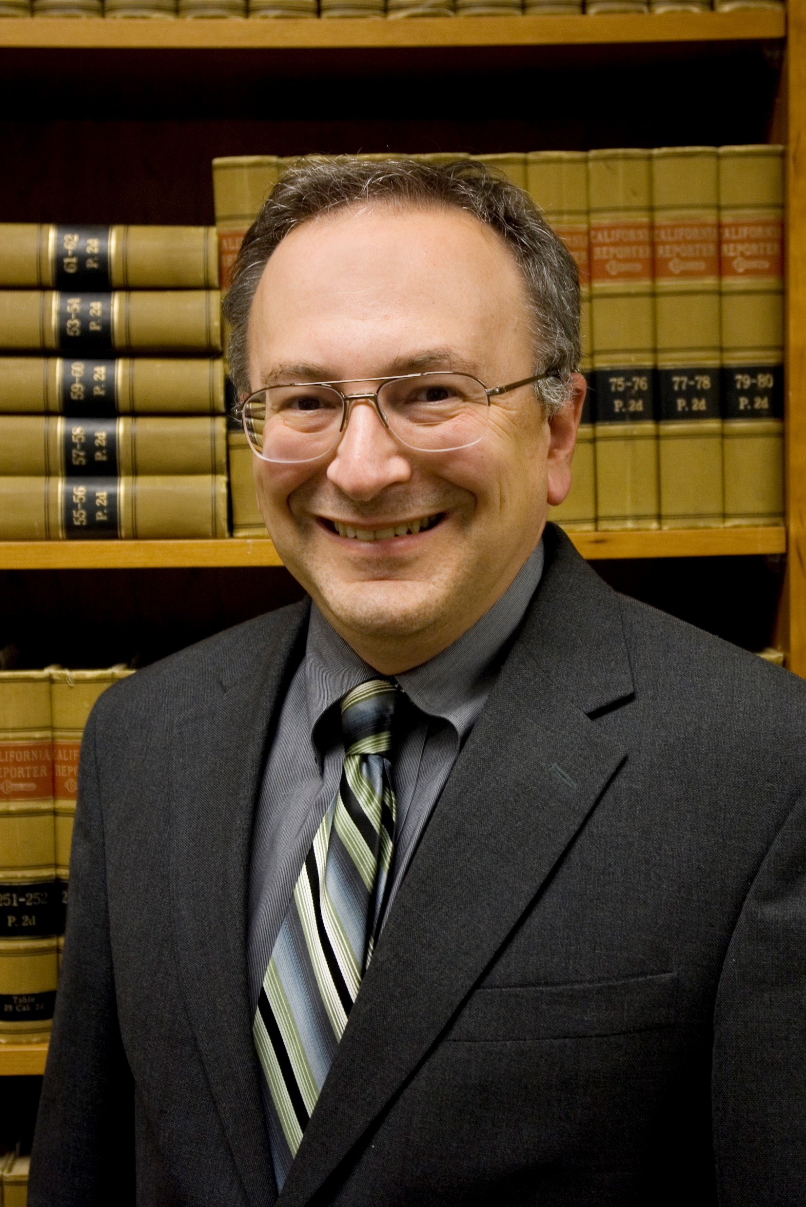
Questions
Your Trusted Legal Guide
Cameron L. Hess, Esq.
Wagner Kirkman Blaine
Klomparens & Youmans LLP
Chess@WKBLAW.com
(916) 920-5286

