Slide 1
Outlook
December 2021
Brian Levitt
Global Market Strategist
For Public Use in the United States and Canada.
US: Not a Deposit; Not FDIC Insured; Not Guaranteed by the Bank; May Lose Value; Not Insured by any Federal Government Agency
Notes:
Editorial title slide layout with CGI background.

Slide 2
Contents
1 Where are we in the cycle?
2 What’s the direction of the economy?
3 What are the policy implications?
4 What are the risks to the outlook?
5 What are the asset class implications?
Notes:
Table of contents.

Slide 3
Where are we in the cycle?
9
8
5
3
6
4
1
2
7
Historically 5-10 Years
Notes:
Section title – large number.

Slide 4
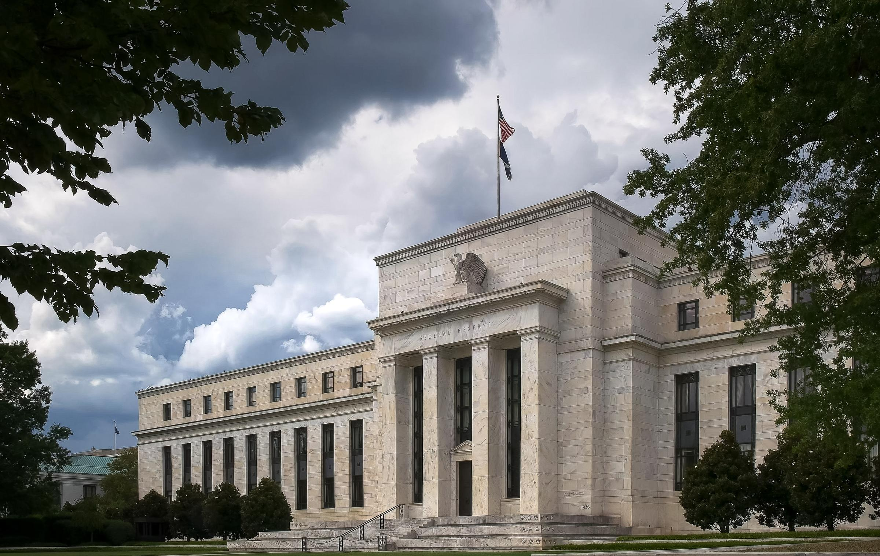
Cycles tend to end with excess, inflation, and policy tightening
Central idea that wraps to multiple lines and sums up the big idea
Source: set in 8pt
Source: GettyImages-1131763915
Notes:
Full bleed stock image + central idea.

Slide 5
Where are we in the cycle?
Leverage
Rises over the cycle
Policy Tightening
US Federal Reserve (Fed) hikes rates to control inflation
Economic growth slows due to tighter policy
Lending Slows
Lending standards tighten due to credit concerns
Source: Stocksy_txp0bffbbd277D300_Medium_2806554
Notes:
Full bleed image with three white boxes.

Slide 6
The cycle is young when measured in years, although the economy had recovered rapidly
US Business Cycles: Length of the cycles and the cumulative advance of real Gross Domestic Product
1991-2001
1982-1991
Average
2001-2007
2009-2019
1973-1981
2020-Present
Sources: Bloomberg L.P. and US Bureau of Economic Analysis. As of September 30, 2021. Latest data available.
Notes:
It is often said that if you get the business cycle right than all else should likely take care of itself. This is because markets lead the business cycle, not vice versa.
The last five elongated US business cycles:
lasted an average 8+ years
produced, on average, a cumulative 25% growth in US real GDP
The current cycle is roughly 1.5 years old. US real GDP has only just recovered to where it was at the beginning of 2020.

Slide 7
Leverage, on a relative basis, is low and lending standards are easy
US Nonfinancial Corporate Debt as a Percentage of the Market Value of Corporate Equities
Senior Loan Officer Opinion Survey: Commercial & Industrial (C&I) Loans for Large/Medium Businesses
Net % of Domestic Respondents Tightening Standards
Shaded areas represent recessions
Sources: Board of Governors of the Federal Reserve System and Bloomberg, 9/21. Latest data available.
Notes:
Cycles tend to culminate as corporate leverage builds and lending standards tighten.
Currently, corporate leverage as a percentage of the market value of corporate equities stands near an historically low level while lending standards are easy.

Slide 8
End of cycle dashboard Inflation is elevated, but the other indicators are not flashing warning signs
US Consumer Price Index
US Treasury Yield Curve (10-Year US Treasury Rate minus 2-Year US Treasury Rate)
Y/Y Percent Change
US Corporate High Yield Bond Spreads
US Dollar Index (DXY)
Basis Points
Source: US Bureau of Labor Statistics, 10/31/21 and Bloomberg, 11/22/21. High Yield bond spreads are represented by the option-adjusted spread of the Bloomberg US Corporate Bond Index. The option-adjusted spread (OAS) is the measurement of the spread of a fixed-income security rate and the risk-free rate of return, which is then adjusted to account for an embedded option, such as calling back or redeeming the issue early. See appendix for index definitions.
Notes:
Historically there have been tell-tale signs that business cycles may be ending.
Inflation is high and rising
The yield curve is flattening meaningfully
High yield spreads are widening
The dollar is strengthening meaningfully
Currently, inflation is elevated and poses a risk to the outlook. However, we expect inflation pressures will moderate as detailed in the following slides. The other three indicators are not signaling that an end to the cycle is near.

Slide 9
Historically stocks have outperformed bonds throughout much of the business cycle
Stock/Bond Ratio
Stocks
outperforming
Bonds
outperforming
Recessions
Source: Bloomberg, 11/23/21. Ratio of the S&P 500 Index level to the Bloomberg Barclays US Aggregate Bond Index as proxies for stocks and bonds, respectively. Index performance is shown for illustrative purposes only and does not depict or predict the performance of any investment. Index definitions are in the appendix. An investment cannot be made into an index. Past performance is no guarantee of future results.
Notes:
Stocks tend to outperform bonds over the course of much of the business cycle, albeit with the inevitable gyrations along the way.

Slide 10
What’s the direction of the economy?
9
8
5
3
6
4
2
7
2
Recovery, Expansion, Slowdown, or Contraction
Notes:
Section title – large number.

Slide 11
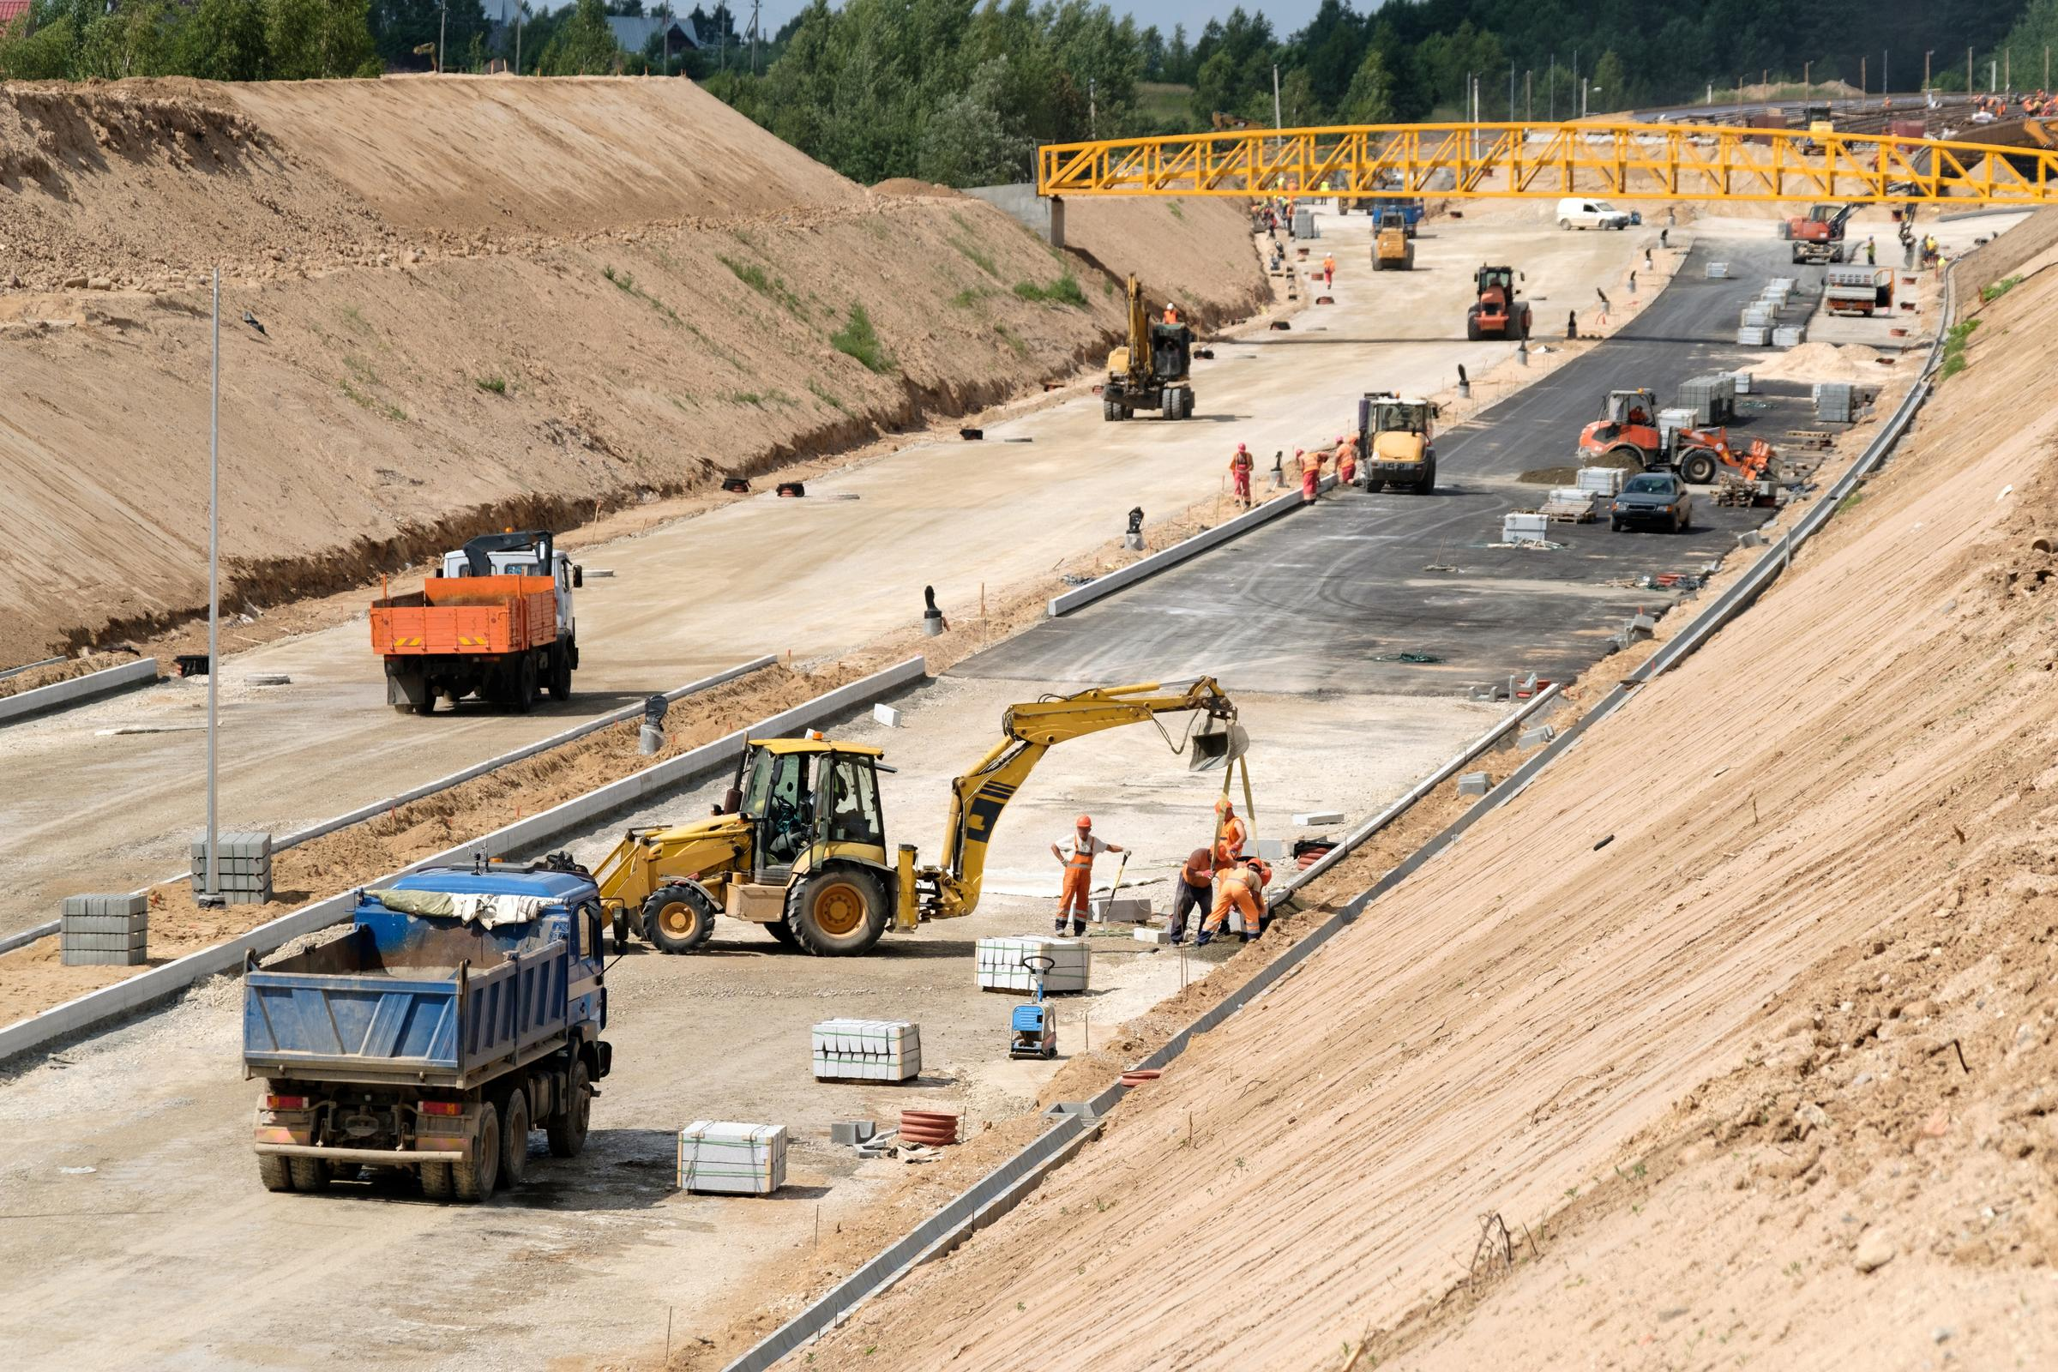
Cycles tend to end with excess, inflation, and policy tightening
Central idea that wraps to multiple lines and sums up the big idea
From Expansion to Slowdown
Source: set in 8pt
Source: AdobeStock_115822697
Notes:
Full bleed stock image + central idea.

Slide 12
The economy, in most areas, has been booming
Consumption:
US Retail Sales
Housing:
Building Permits
New Private Housing Units
Business Investment:
Capital Goods
New Orders Nondefense
Employment:
Job Openings
Billions
Thousands
Billions
Thousands
December 2019
2020 Low
Current
Source: Bloomberg, US Federal Reserve, US Census Bureau, Bureau of Labor Statistics 10/31/21. Latest data available.
Notes:
The US economy had moved from the early recovery phase of the cycle to the expansion phase of the cycle.
In many segments of the economy, including consumption and business investment activity now surpasses the 2019 peak.
However, we do expect the economy to moderate in the coming months from what appear to be unsustainable levels of activity.

Slide 13
A slowdown is likely in the offing
Household Savings Rate
Fiscal Outlays
Est.
% of Disposable Personal Income
% of US Gross Domestic Product
Sources: Bureau of Economic Analysis, US Treasury, 9/30/21.
Notes:
The slowdown will likely be driven by a moderation in US consumption. Household savings rates, while still elevated, have fallen from recent highs as consumers have already unleashed a significant amount of pent-up demand on the economy.
In addition, fiscal support is expected to decline in the coming years.

Slide 14
Financial conditions are tightening, and leading indicators of the economy appear to be rolling
Financial Conditions and Institute for Supply Management (ISM) Manufacturing Purchasing Managers’ Index
Easy financial conditions
support economic growth
Tight financial conditions
restrict economic growth
Sources: Bloomberg L.P., Goldman Sachs, Macrobond, 10/31/21. Notes: The US Financial Conditions Index includes the federal funds rate, 10-year Treasury bond yield, BBB corporate bond spread, S&P 500 and US dollar. PMI = Purchasing Managers Index. Shaded areas denote National Bureau of Economic Research-defined US recessions. An investment cannot be made in an index. See appendix for index definitions. Past performance does not guarantee future results.
Notes:
Finally, we would expect financial conditions to tighten as the US Federal Reserve normalizes monetary policy, resulting in a moderation in activity, including manufacturing.

Slide 15
What are the policy implications?
9
8
5
3
6
4
2
7
3
Notes:
Section title – large number.

Slide 16
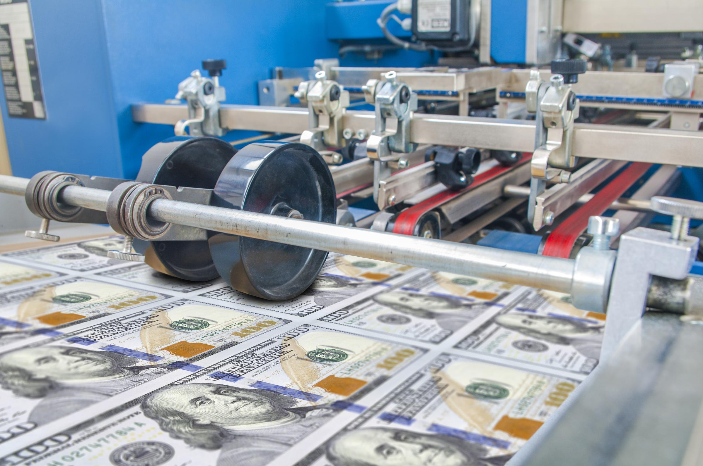
Cycles tend to end with excess, inflation, and policy tightening
Central idea that wraps to multiple lines and sums up the big idea
Tighter, But Not Too Tight
Source: set in 8pt
Source: AdobeStock_220293585_hire-res
Notes:
Full bleed stock image + central idea.

Slide 17
Tighter policy is coming, as per the Fed’s mandate of price stability and full employment
Inflation Breakeven
Unemployed, Part-Time, and Marginally Attached to the Labor Force, % of Total Labor Force
3.89%
3.16%
3.04%
2.63%
Sources: Bloomberg 11/22/21, Bureau of Labor Statistics, 10/31/21. The breakeven inflation rate is calculated by subtracting the yield of an inflation-protected bond from the yield of a nominal bond during the same time period.
Notes:
The US Federal Reserve is likely to tighten monetary policy as inflation expectations are elevated above their perceived comfort zone and as the economy moves closer to full employment.

Slide 18
What are the risks to the outlook?
9
8
5
3
6
4
2
7
4
Notes:
Section title – large number.

Slide 19
The Risks Are Elevated But Are Unlikely to End the Cycle
Cycles tend to end with excess, inflation, and policy tightening
Central idea that wraps to multiple lines and sums up the big idea
Source: set in 8pt
Source: AdobeStock_284406259
Notes:
Full bleed stock image + central idea.

Slide 20
The Risks Inflation, COVID, and asset bubbles top the list of risks to the outlook
Survey: What do you consider the biggest risk?
Source: Cogent, 10/31/21.
Notes:
Ironically, investors have quickly gone from worrying about the disastrous economic outcome resulting from the coronavirus outbreak to concerns that the economy is now overheating.
Let’s address each of these concerns.

Slide 21
Risk: Inflation
Inventory to Sales Ratio: Retail
Current 1.09
Billions
Average Inventory to Sales Ratio: 1.52
Source: US Census Bureau, 10/31/21. Latest data available. The inventory to sales ratio represents the relationship between the inventory value at US retailers and the total sales of US retailers.
Notes:
Milton Friedman’s famous quip is apropos for the current environment.
US consumers are spending. Businesses, fearing a prolonged economic downturn, had cut workers and slashed inventories. Too much money is chasing too few goods and inflationary pressures are mounting.
Some inflation is a good thing as consumers shop today when they expect prices to rise in the future.
However, too much inflation can be a problem. Rising prices creates uncertainty. For example, businesses may invest less today if they are uncertain about future costs.

Slide 22
Signs that the consumer is shifting a proportion of their spending from durable goods to services
Personal Consumption Expenditures: Durable Goods
Personal Consumption Expenditures: Services
16 Months
Billions
3 Months
Billions
Source: Bureau of Economic Analysis, 10/31/21.
Notes:
We would expect consumers to shift a portion of their spending away from durable goods and towards services, providing time for businesses to rebuild inventories.

Slide 23
Supply chain challenges
Signs of hope?
World Container Index Composite Container Freight Index Benchmark Rate
Polyethylene Spot Prices
Semiconductor Price
Nonfarm Payrolls: Truck Transportation
Freight costs peaking?
Costs of packaging inputs falling
Semiconductor prices falling
Truckers returning to labor force
$/40-foot box
Spot Price: Double Data Rate Fourth Generation, 8 Gigabyte
Thousand
Per Metric Ton
Source: World Container Index, Dalian Commodity Exchange, inSpectrum Tech, and Bureau of Labor Statistics, 10/31/21.
Notes:
We seeing early signs that supply-chain challenges may be easing.
Freight costs may have peaked
The prices of polyethylene, found in packaging, has declined meaningfully in recent weeks
Semiconductor prices have eased as supply and demand moves closer to balance
Truckers are returning to the workforce, suggesting that more goods will be transported to where required

Slide 24
Risk: COVID-19
Share of Population Vaccinated Against COVID-19 – Select G20 Countries
Sources: World Health Organization, Our World in Data, 11/21.
Notes:
COVID remains a concern for investors but is no longer the primary concern.
That is a testament to the vaccine rollouts in the US, UK, the European Union and select countries in the emerging markets.

Slide 25
Risk: Bubble On Wall Street
S&P 500 Index Price and Earnings
S&P 500 Index Annualized Returns
5-Years After Post-Recession P/E Peak
S&P 500 Index (Logarithmic Scale)
25.3x
24.2x
S&P 500 Index Earnings Per Share (Logarithmic Scale)
Price
27.8x
P/E
26.8x
Earnings
Sources: Morningstar, Investment Company Institute, 10/31/21. P/E is the price to earnings ratio of the S&P 500 Index is a ratio comparing the price of the companies in the S&P 500 divided by the earnings per share of the companies in the S&P 500 Index. S&P 500 Index price returns in U.S. dollars. See appendix for index definitions. An investment cannot be made into an index. Past performance does not guarantee future results.
Notes:
Markets tend to appear overvalued in the early aftermath of a recession. That is because markets tend to recover before the economy and corporate earnings recover. Hence, the price to earnings ratio climbs.
Typically, equity valuations often come down as the cycle progresses and corporate earnings grow. In fact, corporate earnings in Q321 were among the strongest on record and are poised to climb higher in future quarters (Source: Bloomberg, Standard & Poor’s).
Our research in the chart on the right suggests that the stock market tends to perform well in the 5-years following a post recession peak in the price to earnings ratio (Source Bloomberg, Invesco).

Slide 26
What are asset class implications?
9
8
5
3
6
4
2
7
5
Notes:
Section title – large number.

Slide 27
Tactical Asset Allocation: Macro Framework
Note: Economies can move backwards and forwards in this framework.
Recovery
Growth ▼below trend &
▲accelerating
Expansion
Growth ▲above trend &
▲accelerating
Slowdown
Growth ▲above trend &
▼decelerating
Contraction
Growth ▼below trend &
▼decelerating
Economic Regime
Monetary Policy Direction
Easing
Still Easy
Tightening
Tight
Risk Credit
High Yield, Bank Loans
EM Local Debt
Equity
Growth, Value, Small
Emerging Markets
Equity
Growth, Large
Developed Markets
Government Bonds
Long Duration
Nominal Bonds
Equity
Cyclicals, Value, Small
Emerging Markets
Risk Credit
High Yield, Bank Loans
EM Hard Currency
Government Bonds
Long Duration
Nominal Bonds
High Quality Credit
IG Corporate
Market Leadership
(Ranked by expected outperformance)
High Quality Credit
IG Corporate
High Quality Credit
IG Corporate
High Quality Credit
IG Corporate
Risk Credit
High Yield, Bank Loans
EM Hard Currency
Government Bonds
Intermediate Duration
Nominal Bonds
Government Bonds
Short Duration
Inflation-Linked Bonds
Risk Credit
High Yield, Bank Loans
EM Hard Currency
Equity
Developed, Defensive
Low Volatility
For illustrative purposes only. We define policy easing as the US Federal Reserve lowering interest rates and/or expanding their balance sheet. Still easy suggests that the US Federal Reserve is maintaining the lower interest rate policy and/or continuing their bond-buying program. Tightening suggests that the US Federal Reserve is tapering asset purchases and/or beginning to raise interest rates. Tight policy suggests that the US Federal Reserve is raising rates in an effort to ease inflation concerns.
Notes:
The economy appears to have entered the slowdown phase of the cycle.
Monetary policy is expected to be tighter.
History suggests that slowdowns continue to favor equities with longer-duration assets such as growth stocks and government-related bonds performing well.

Slide 28
Longer duration assets, including government bonds and growth stocks, have tended to perform well in a slowdown
10-Year US Treasury Rate and Mid-Cycle Slowdowns
Average Returns During Mid-Cycle Slowdowns
1995, 1998, 2015, 2018
1995
14% | 19% | 22% | Large
11% | 13% | 17% | Medium
4% | 7% | 10% | Small
Value | Blend | Growth
1998
2018
2015
Shaded areas represent mid-cycle slowdowns
Source: Bloomberg. * Returns are gross of fees. Indices cannot be purchased directly by investors. Style box returns are represented by Russell indices. Small-cap growth, small-cap blend, and small-cap value are represented by Russell 2000 Growth Index, Russell 2000 Index, and Russell 2000 Value Index, respectively. Mid-cap growth, mid-cap blend, and mid-cap value are represented by Russell Midcap Growth Index, Russell Midcap Index, and Russell Midcap Value Index, respectively. Large-cap growth, large-cap blend, and large-cap value are represented by Russell 1000 Growth Index, Russell 1000 Index, and Russell 1000 Value Index, respectively. Past performance does not guarantee future results.
Notes:
Bond yields tend to peak ahead of mid-cycle slowdowns and growth stocks, across market capitalization, tend to outperform.

Slide 29
Finding growth in a slow(ing) growth world
Annualized growth rates of select components of the global economy
Annualized Growth
Past 5 Years
Forecasted Growth
Source of Global GDP: International Monetary Fund as of 9/30/20. Source of luxury goods consumption: Statista, based on estimated annualized growth from 2021-2025. Source of middle-class consumption: Brookings based on estimates from 2020-2030. Source of noncash transactions: World Payments and Business Insider Intelligence Report, based on estimated annualized growth from 2019-2024. Source of cloud computing: Statista based on estimated annualized growth rate from 2019-2027. Source of internet of things connectivity: Ericsson based on estimated annualized growth from 2019-2024. Source of digital health: Statista based on estimates from 2019-2025. Source of global mobile data: Cisco Systems based on estimates from 2018-2022. Forecasts may not prove accurate.
Notes:
In a slowing growth world, investors tend to favor segments of the market that are growing faster than the broad economy.
In the visual above we represent select segments of the global economy that are expected to grow at outsized rates.

Slide 30
2022 Outlook
The cycle is still likely relatively young
The business cycle is progressing faster than in past cycles but is likely to have substantial room to run
The economy appears to be slowing
Growth rates are likely to moderate from unsustainable levels resulting in moderating inflationary pressures
Risk assets still likely to outperform
The backdrop is still conducive for risk assets, although we would expect leadership to shift away from the so-called “recovery trade”
Source: GettyImages-1226216285
Notes:
Left hero picture plus three key takeaways.

Slide 31
Important information
The opinions expressed are those of the author, are based on current market conditions and are subject to change without notice. These opinions may differ from those of other Invesco investment professionals. These comments should not be construed as recommendations, but as an illustration of broader themes. Forward-looking statements are not guarantee of future results. They involve risks, uncertainties and assumptions; there can be no assurance that actual results will not differ materially from expectations.
This does not constitute a recommendation of any investment strategy or product for a particular investor. Investors should consult a financial professional before making any investment decisions.
In general, stock values fluctuate, sometimes widely, in response to activities specific to the company as well as general market, economic and political conditions.
currencies, political and economic instability, and foreign taxation issues.
Larger, more established companies may be unable to respond quickly to new competitive challenges such as changes in consumer tastes or innovative smaller competitors. Returns on investments in large capitalization companies could trail the returns on investments in smaller companies.
Stocks of small-sized companies tend to be more vulnerable to adverse developments, may be more volatile, and may be illiquid or restricted as to resale.
Fixed-income investments are subject to credit risk of the issuer and the effects of changing interest rates. Interest rate risk refers to the risk that bond prices generally fall as interest rates rise and vice versa. An issuer may be unable to meet interest and/or principal payments, thereby causing its instruments to decrease in value and lowering the issuer’s credit rating.
Investments in financial institutions may be subject to certain risks, including the risk of regulatory actions, changes in interest rates and concentration of loan portfolios in an industry or sector.
Notes:
Disclosure slide.

Slide 32
Index Definitions
Gross Domestic Product (GDP) is a measure of all of the goods and services produced within an economy during a year.
Consumer Price Index (CPI) program produces monthly data on changes in the prices paid by urban consumers for a representative basket of goods and services.
The Goldman Sachs US Financial Conditions Index is a weighted average of riskless interest rates, the exchange rate, equity valuations, and credit spreads, with weights that correspond to the direct impact of each variable on GDP.
The S&P 500 Index is a market-capitalization-weighted index of the 500 largest domestic US stocks.
The Russell 1000 Growth Index measures the performance of those Russell 1000 companies with higher price-to-book ratios and higher forecasted growth values.
The Russell 1000 Value Index measures the performance of those Russell 1000 companies with lower price-to-book ratios and lower forecasted growth values.
The Russell 2000 Index measures the performance of small-capitalization stocks.
The Russell 2000 Growth Index measures the performance of those Russell 2000 companies with higher price-to-book ratios and higher forecasted growth values.
The Russell 2000 Value Index measures the performance of those Russell 2000 companies with lower price-to-book ratios and lower forecasted growth values.
The Russell 1000 Growth Index measures the performance of those Russell 1000 companies with higher price-to-book ratios and higher forecasted growth values.
The Russell 1000 Value Index measures the performance of those Russell 1000 companies with lower price-to-book ratios and lower forecasted growth values.
The Russell 2000 Index measures the performance of small-capitalization stocks.
The Russell 2000 Growth Index measures the performance of those Russell 2000 companies with higher price-to-book ratios and higher forecasted growth values.
The Russell 2000 Value Index measures the performance of those Russell 2000 companies with lower price-to-book ratios and lower forecasted growth values.
The Russell Midcap Index measures the performance of mid-capitalization stocks.
The Russell Midcap Growth Index measures the performance of those Russell Midcap companies with higher price-to-book ratios and higher forecasted growth values.
The Russell Midcap Value Index measures the performance of those Russell Midcap companies with lower price-to-book ratios and lower forecasted growth values.
Institute for Supply Management (ISM) Manufacturing Index is an index measures manufacturing activity based on a monthly survey, conducted by ISM, of purchasing managers at more than 300 manufacturing firms.
The Bloomberg U.S. Aggregate Bond Index is designed to measure the performance of investment grade bonds in the United States.
The Bloomberg US Corporate High Yield Bond Index tracks the performance of below-investment-grade, US-dollar-denominated corporate bonds publicly issued in the US domestic market.
MSCI ACWI Index is an unmanaged index considered representative of stocks of developed and emerging market countries. The index is computed using the net return, which withholds applicable taxes for nonresident investors.
The World Container Index reports actual spot container freight rates for major East West trade routes, consisting of 8 route-specific indices representing individual shipping routes and a composite index. All indices are reported in USD per Forty Foot Container.
The U.S. Dollar Index (USDX) indicates the general international value of the US dollar. The U.S. Dollar Index does this by averaging the exchange rates between the US dollar and major world currencies.
The Credit Suisse Leveraged Loan Index is a composite index of senior loan returns representing an unleveraged investment in senior loans that is broadly based across the spectrum of senior bank loans and includes reinvestment of income.
The Barclays Aggregate Corporate Bond Index represents primarily investment-grade corporate bonds within the Barclays Aggregate Bond Index.
The Bloomberg US Treasury: 7-10 Year Index measures US dollar-denominated, fixed-rate, nominal debt issued by the US Treasury with 7-9 years to maturity.
Polyethylene spot price represents the price in US dollars of polyethylene.
Semiconductor spot price represents the price in US dollars of Double Data Rate Fourth Generation, 8 Gigabyte semiconductors.
US Employees on Nonfarm Payrolls-Trucking Transportation represents the number of people on business payrolls employed by trucking transportation businesses.
Indexes are unmanaged and cannot be purchased directly by investors. Index performance is shown for illustrative purposes only and does not predict or depict the performance of any investment. Past performance does not guarantee future results.
Notes:
Disclosure slide.

Slide 33
Disclosures
For US Audiences:
All data provided by Invesco unless otherwise noted. Invesco Distributors, Inc.
©2021 Invesco Ltd. All rights reserved.
For Canadian Audiences:
Commissions, trailing commissions, management fees and expenses may all be associated with mutual fund investments. Mutual funds are not guaranteed, their values change frequently and past performance may not be repeated. Please read the simplified prospectus before investing. Copies are available from Invesco Canada Ltd.
Most references are US centric and may not apply to Canada.
Publication date: December 1, 2021
Invesco® and all associated trademarks are trademarks of Invesco Holding Company Limited, used under license.
©2021 Invesco Canada Ltd
NA1935286
WMI22-PPT-1 11/21
Notes:
Disclosure slide.

Slide 34
Thank you
ADMASTER-STAMP!20211201-1935286-NA
20211201-1935286-NA
Notes:
Thank you / Q&A slide.

